Slide 1

Classification of Documents Using NLP
Team Name: Team 3
Mentor Name: Sir. Rajshekar & Ma’am Pallavi
Date: 21/004/2022

Slide 2
Business Problem:
Classification of Documents.
Business Objective:
To Classify the Document & Create a Document Parsing Web Application

Slide 3
Project Architecture / Project Flow
Understand the Unstructured Data
EDA / Pre-process Data
Apply Classification Algorithms
Evaluate & Compare Performance
Finalize a Model & Implement Parsing System
Deployment of the System

Slide 4
Exploratory Data Analysis (EDA)

Slide 5
Data set details
Original Dataset :
The dataset consists of Resumes type Documents.
There is total 79 resumes in the dataset.
There are 3 filetype in the dataset which are:
(.doc)
(.docx)
(.pdf)

Slide 6
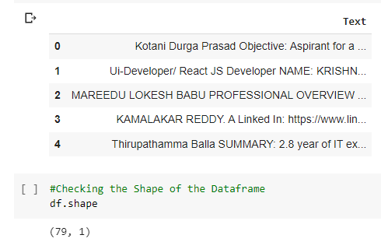
Approach: Filetype conversion – Converted all the file with filetype of (.doc) & (.pdf) to (.docx) extension. List of Resumes as Text – Converted all the resumes as a entire single text and Stored in a list, So the list has 79 elements for 79 different resumes. Adding Fake Entities – In these resumes there were no entities like email, phone number, LinkedIn, GitHub etc. So added these Fake information like for phone no : 1234567890 for all resumes. As we would require our model to learn these pattern / entities and parse the resume. Added all these Entities at the last of the text for each resumes. Stored it in Data Frame: Converted the list into a Dataframe. .
EDA – Preprocessing

Slide 7
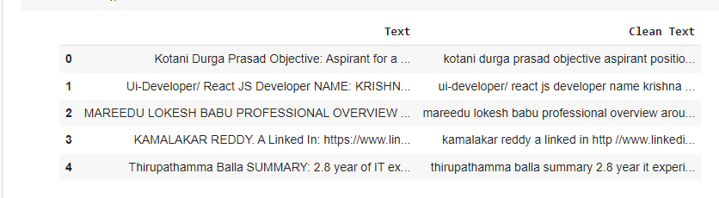
EDA – Data Cleaning
Approach:
Used the NLTK Library: To remove stopwords, punctuation.
Wordnet – Lemmatization etc.
Stored the clean Text into a Dataframe

Slide 8
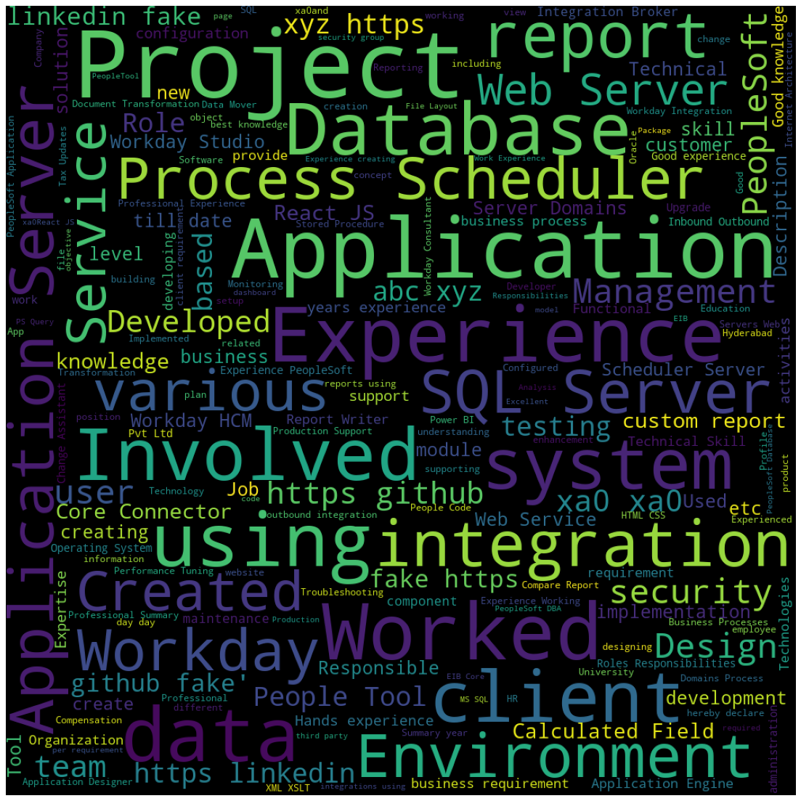
WordCloud: For commonly used words in the resumes - Words like Experience, SQL Server, Environment, Database, GitHub are used very regularly.
EDA - Visualization

Slide 9
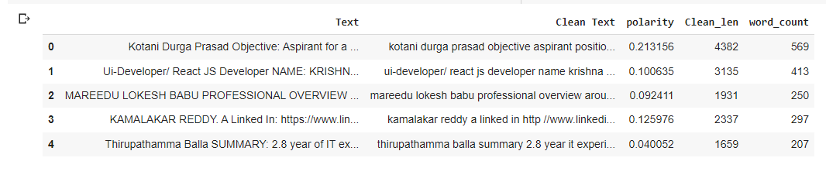
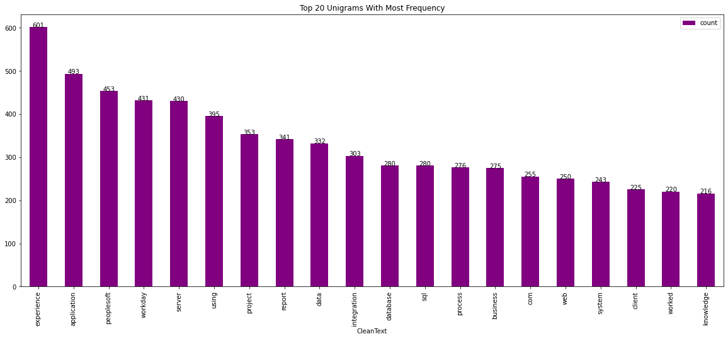
Unigrams: Distributions of Top 20 Unigrams
EDA – Visualizations
Plotting N - Grams: Created a new Dataframe with Polarity, Text Length & word count Features.

Slide 10
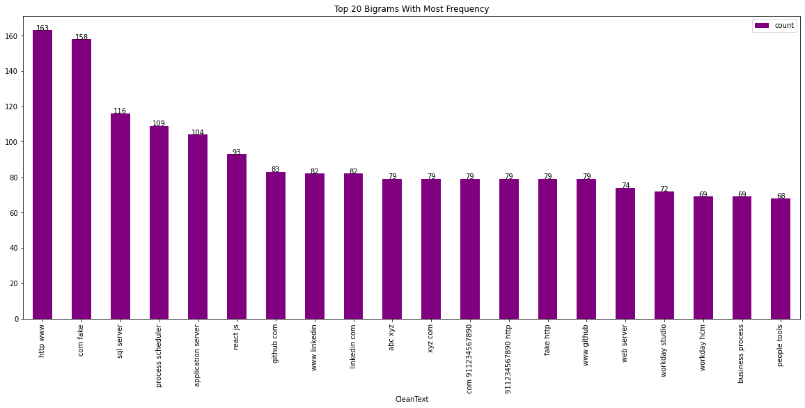
EDA – Visualizations
Bigrams: Distribution of Top 20 Bigrams

Slide 11
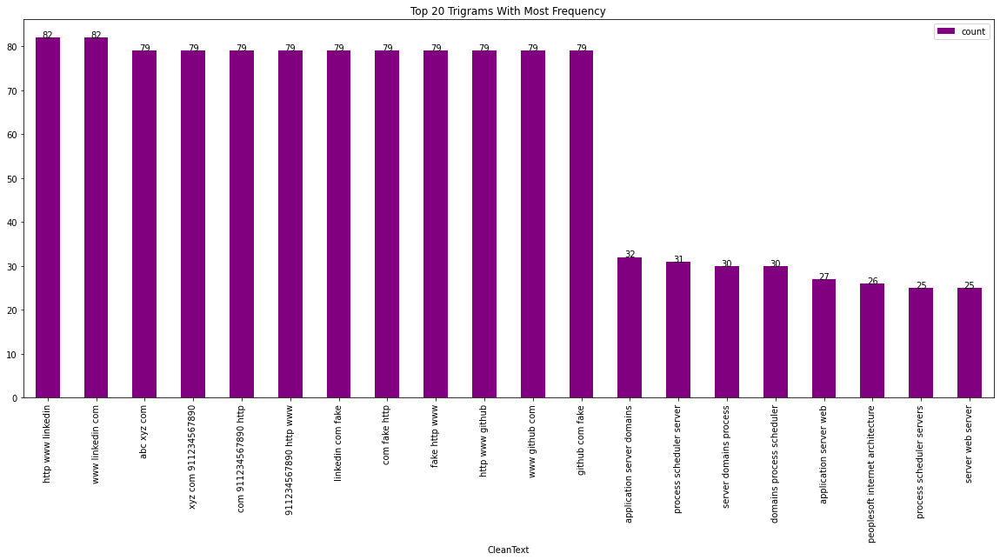
EDA – Visualizations
Trigrams: Distribution of Top 20 Trigrams

Slide 12
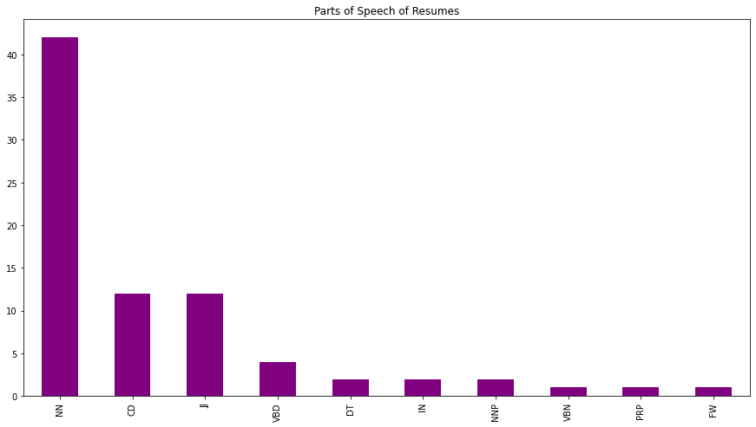
EDA – Visualizations
Parts of Speech: Distribution of Top Part of Speech in Resumes

Slide 13
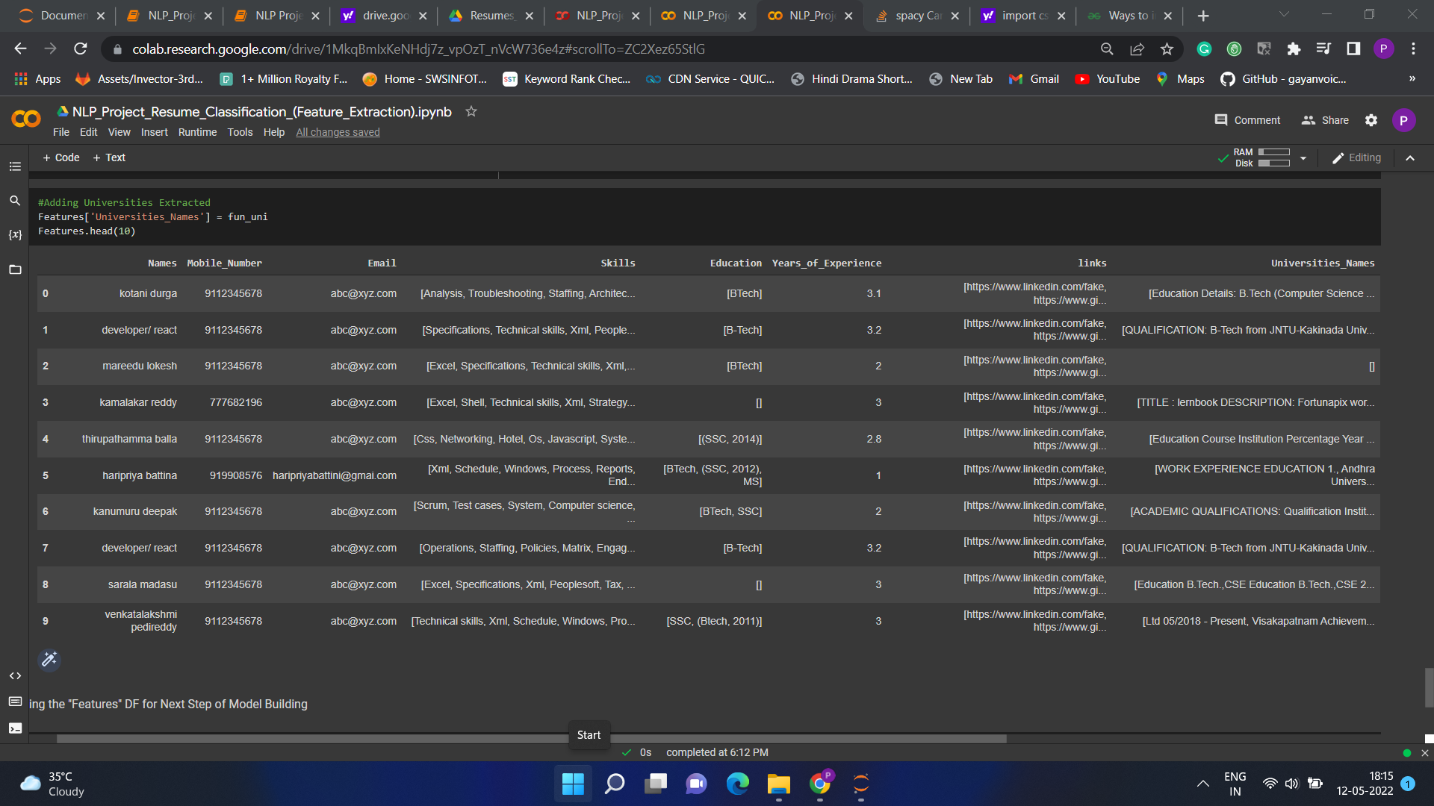
Feature Extraction
Feature like name, mobile number, email, link, education, experience, university are Extracted using Regex(Regular Expression) & SciPy.
Feature like Skills is extracted using resume parser library.

Slide 14
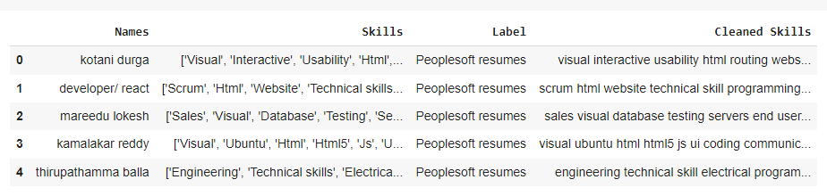
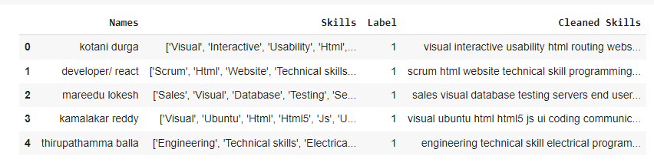
Model Building
Classes of Resumes:
There are 5 classes we assigned based on resumes names which as follows
Peoplesoft resumes
React resumes
SQL Developer Lightning insight
Workday resumes
Different resumes
Approach: Moved the Resumes to 5 different folders of the above class, then used a function that gives Label (class) to each resumes based on folder name.
Label Encoding: Label Encoded the classes

Slide 15
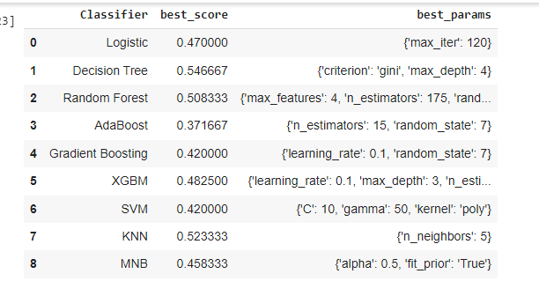
Model Building
GridSearch CV: Finding Best Algorithms
Inference: We got Decision Tree as Best result. So will built final Model on DT.
Final Model (Decision Tree) .
Inference: Final Accuracy of DT on Entire Dataset is 78.48%.

Slide 16
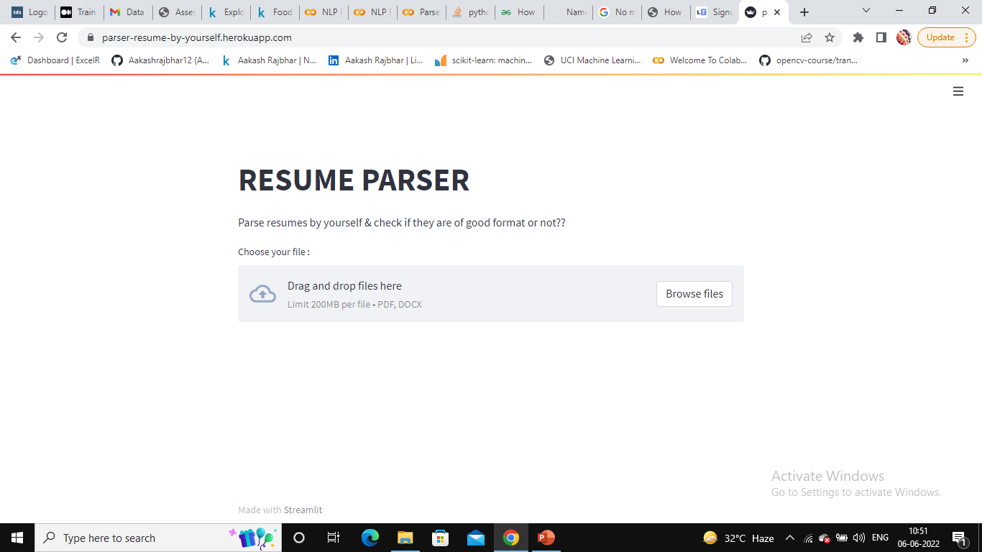
Deployment
Snip of Deployed Application
Used Streamlit & Heroku Cloud Services.

Slide 17
THANK YOU

